Slide 1
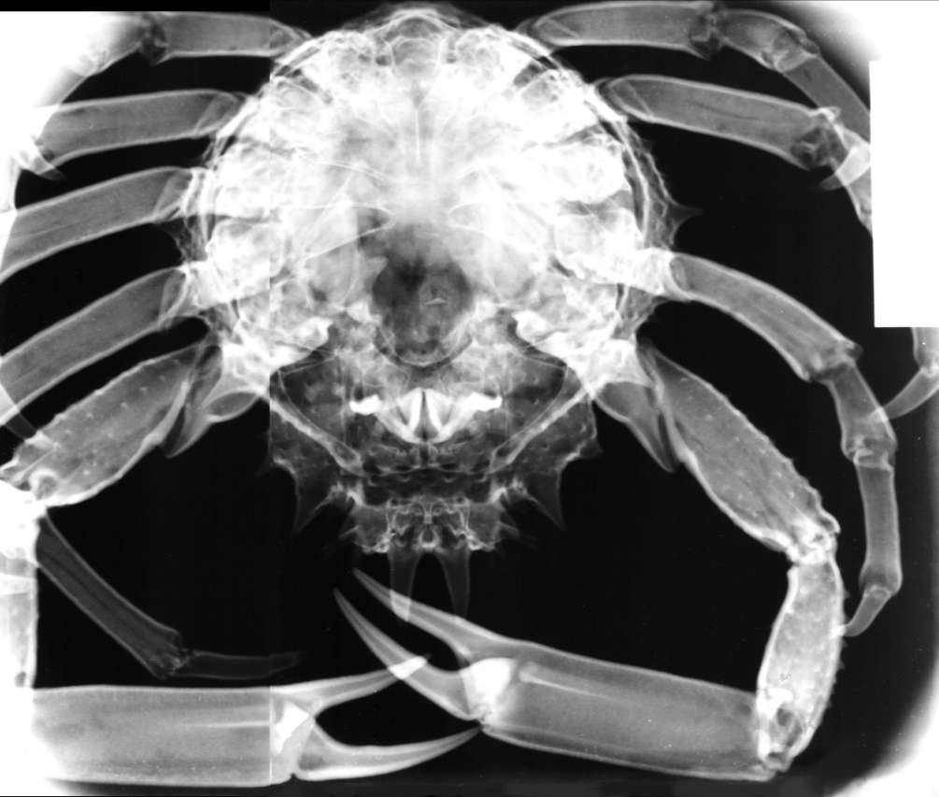
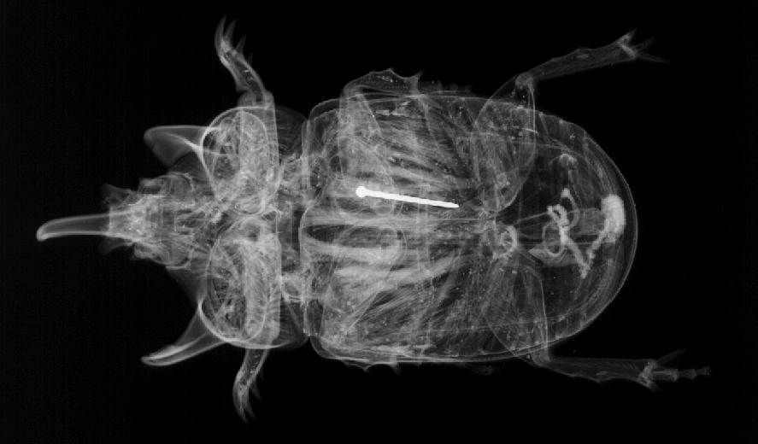
Invertebrates
Wenting Chai

Slide 2
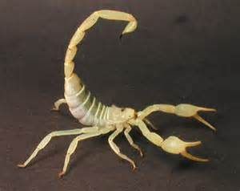
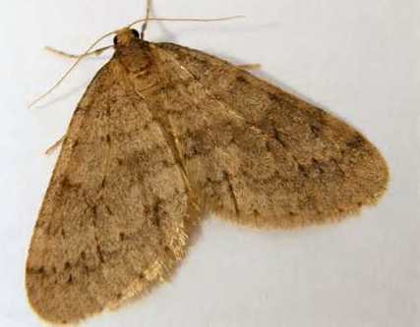
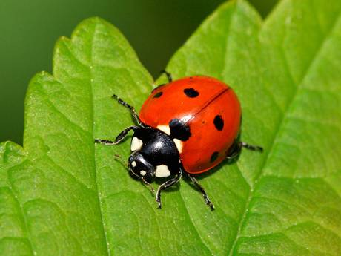
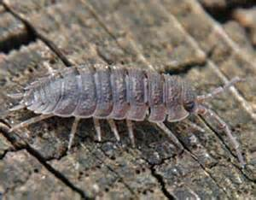
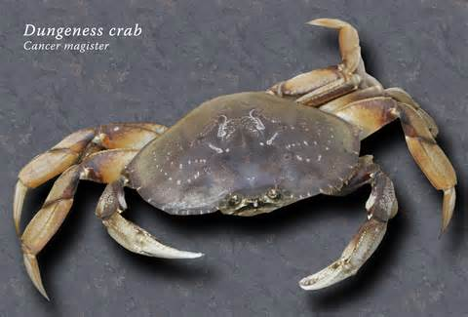
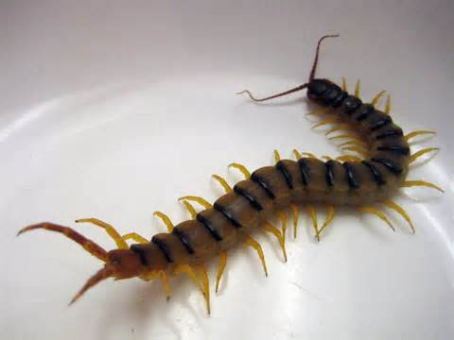
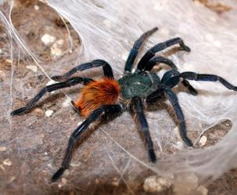
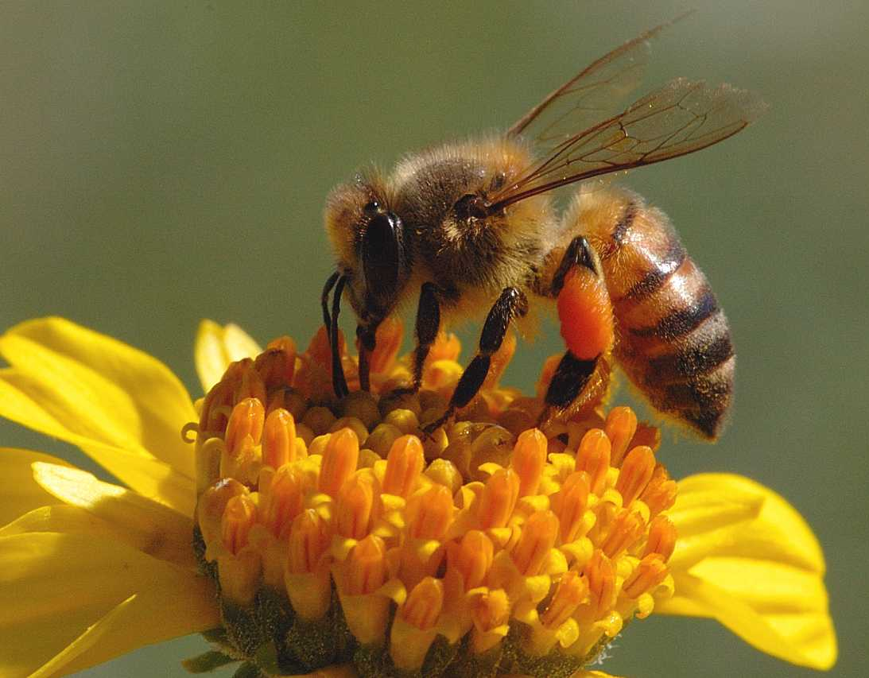
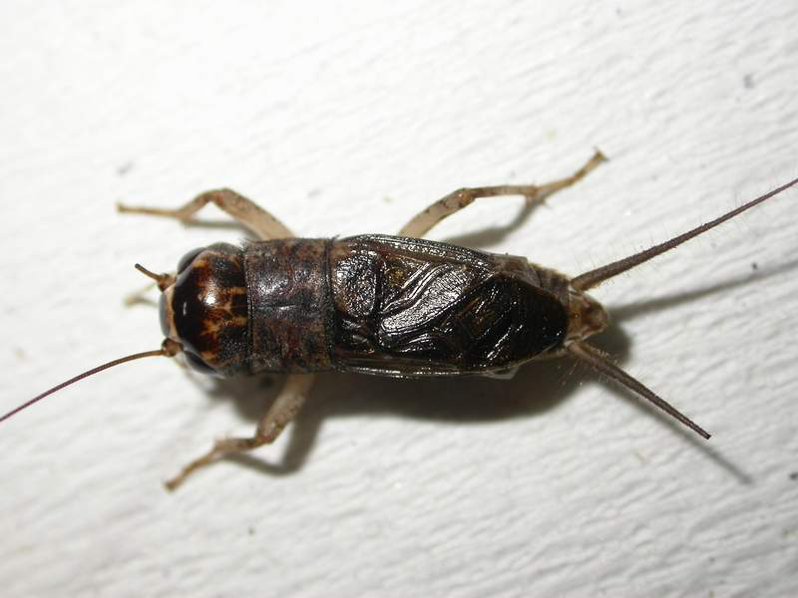
Arthropods
moth
Lady bird/ ladybug
scorpion
woodlouse
crab
centipede
spider
bee
cricket

Slide 3
Arthropods
a waterproof exoskeleton (external skeleton), mainly made of α-chitin and/or calcium carbonate
a segmented body
jointed appendages
Arthropods have 1,170,000 described species, and account for over 80% of all known living animal species.

Slide 4
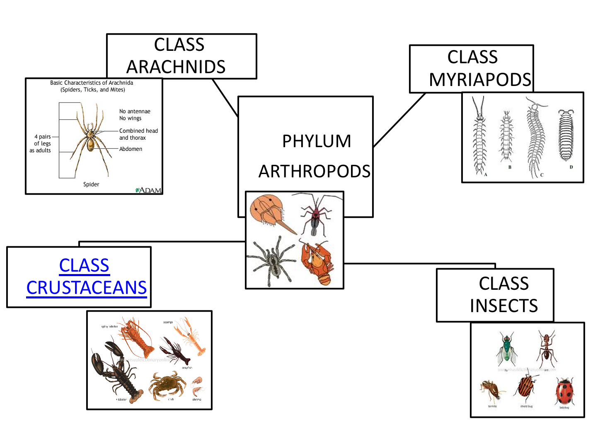

Slide 5
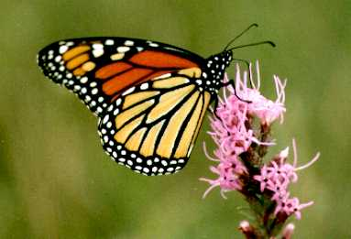
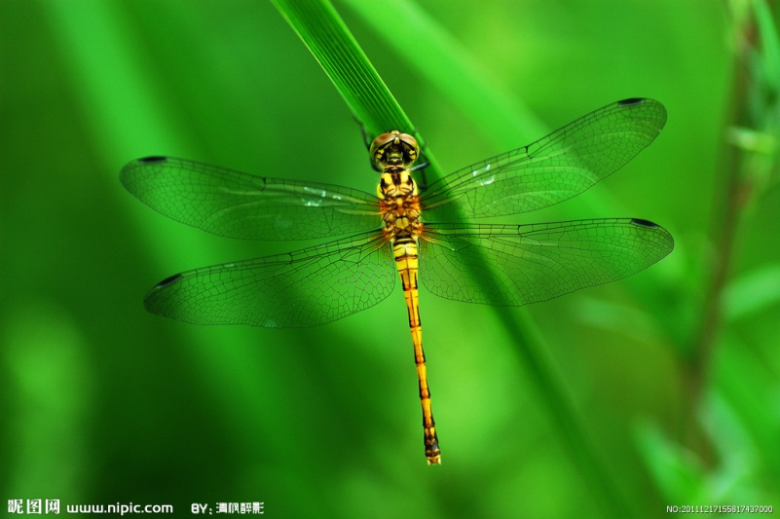
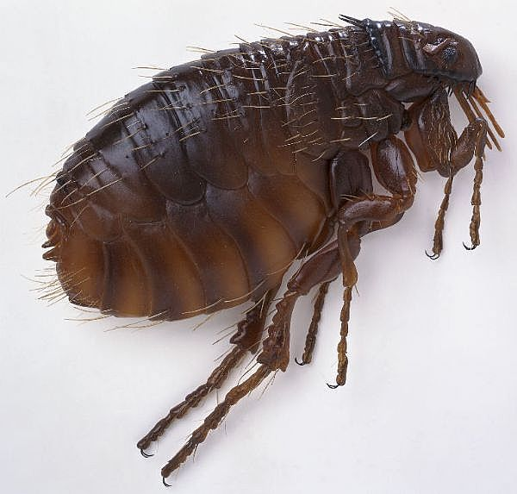
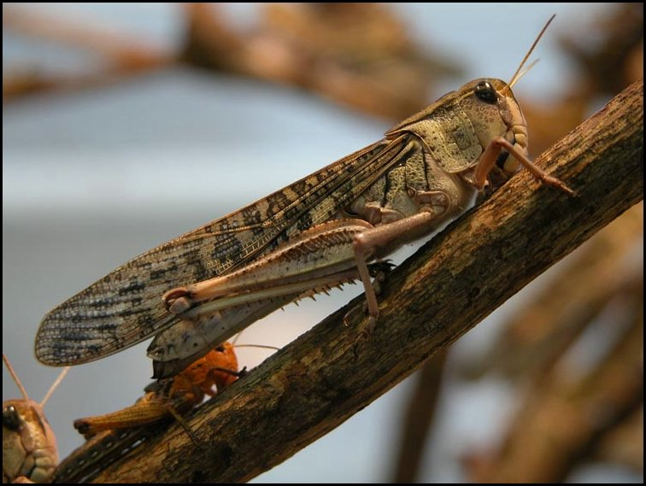
Insects
butterfly
ladybird
dragonfly
flea
moth
Honey bee
locust
cricket
Notes:
1.cricket，蟋蟀；flea跳蚤，小型、无翅、善跳跃的寄生性昆虫，成虫通常生活在哺乳类动物身上，少数在鸟类；locust,蝗虫；
1.昆虫的身体分为头、胸、腹三部分。成虫通常有2对翅和6条腿，翅和足都位于胸部，身体由一系列体节构成，进一步集合成3个体段（头、胸和腹）。一对触角头上生，骨骼包在体外部；一生形态多变化，遍布全球旺家族。是节肢动物中种类最多的一种。

Slide 6
Insects
Insects are a class of invertebrates within the arthropod phylum that have compound eyes and one pair of antennae.
Characteristics:
1) three pairs of jointed legs
2) two pairs of wings(one or more may be vestigial)
3) breathe through tracheae

Slide 7
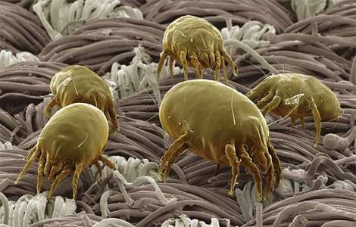
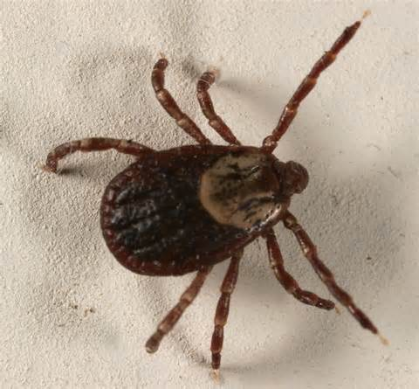
Arachnids
mite
scorpion
spider
tick
Notes:
1.Arachnid,蛛形纲；tick，蜱；mite,螨

Slide 8
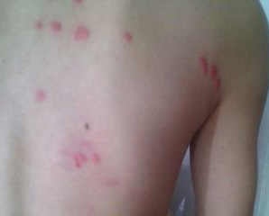
Arachnids
All adult arachnids have eight legs. They are land-dwelling organisms.
Characteristics:
1) four pairs of jointed legs.
2) breathe through gills called book lungs.
They also have several pairs of simple eyes and
[two pairs of appendages on head, one pair of chelicerae for biting and poisoning prey, one pair of pedipalps for reproduction].

Slide 9
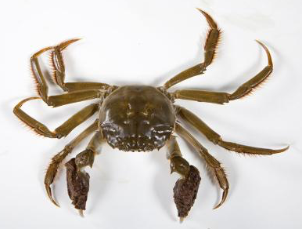
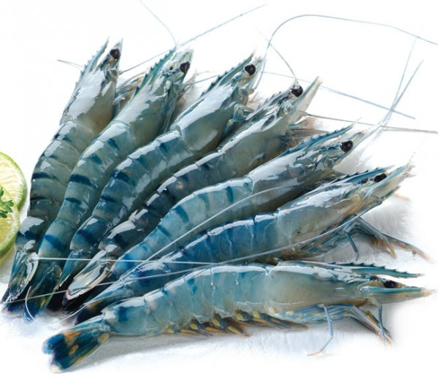
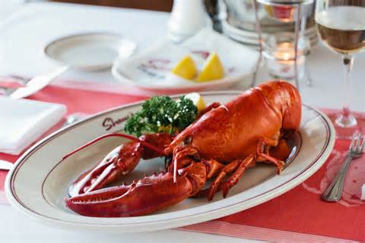
Crustaceans
Crab
Woodlouse
Shrimp
Lobster
Notes:
1.krill,磷虾；woodlouse,鼠妇；shrimp,虾；

Slide 10
Crustaceans
They breathe through gills, so most of them live in wet places and many are aquatic.
Characteristics:
1) more than four pairs of jointed legs
2) breathe through gills
They also have two pairs of antennae.
e.g. crabs, lobsters, woodlice, shrimp, krill.

Slide 11
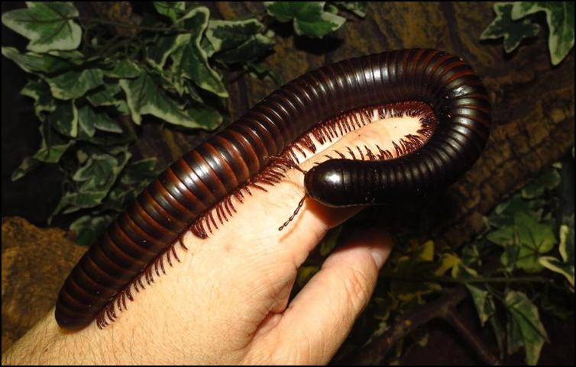
Myriapods
Myriapoda contains millipedes, centipedes, and others. myriapods range from having over 750 legs to having fewer than ten legs. They have one pair of antennae and simple eyes.
Characteristics: 1) body consists of many segments.
2) each segment has jointed legs.
centipede
millipede
Notes:
1.myriapod，多足纲；centipede，蜈蚣；millipede,马陆

Slide 12


Break!!!

Slide 13


Slide 14
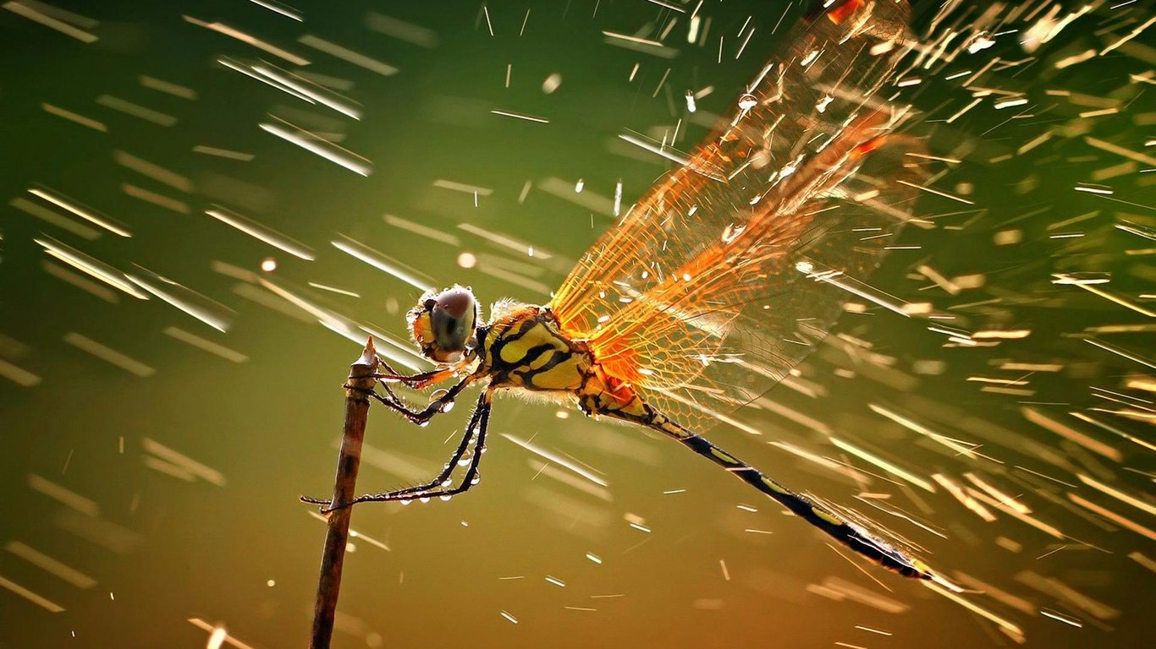
Dragonfly, Class Insects

Slide 15


Dolphin, Class Mammals

Slide 16
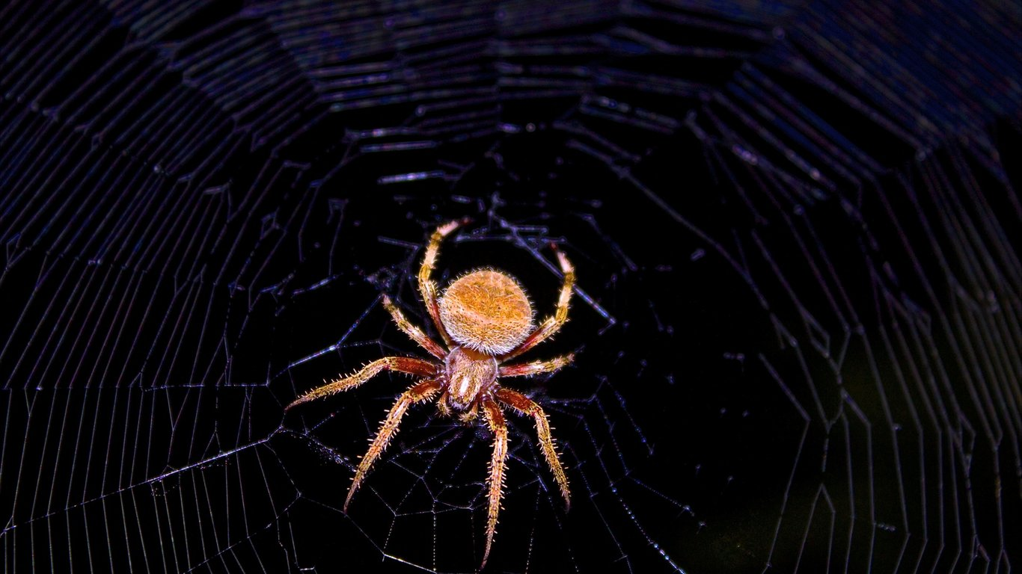
Spider, Class Arachnid

Slide 17
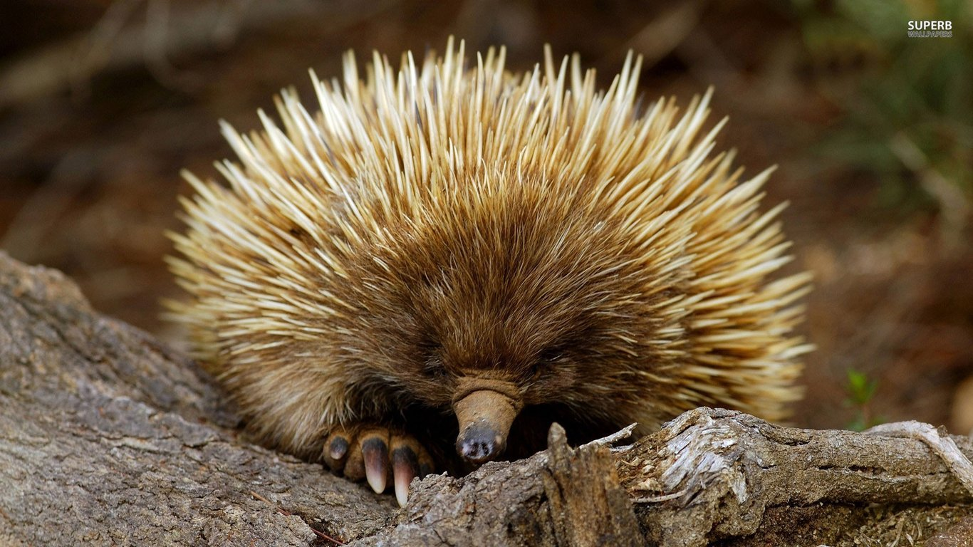
Hedgehog, Class Mammals

Slide 18

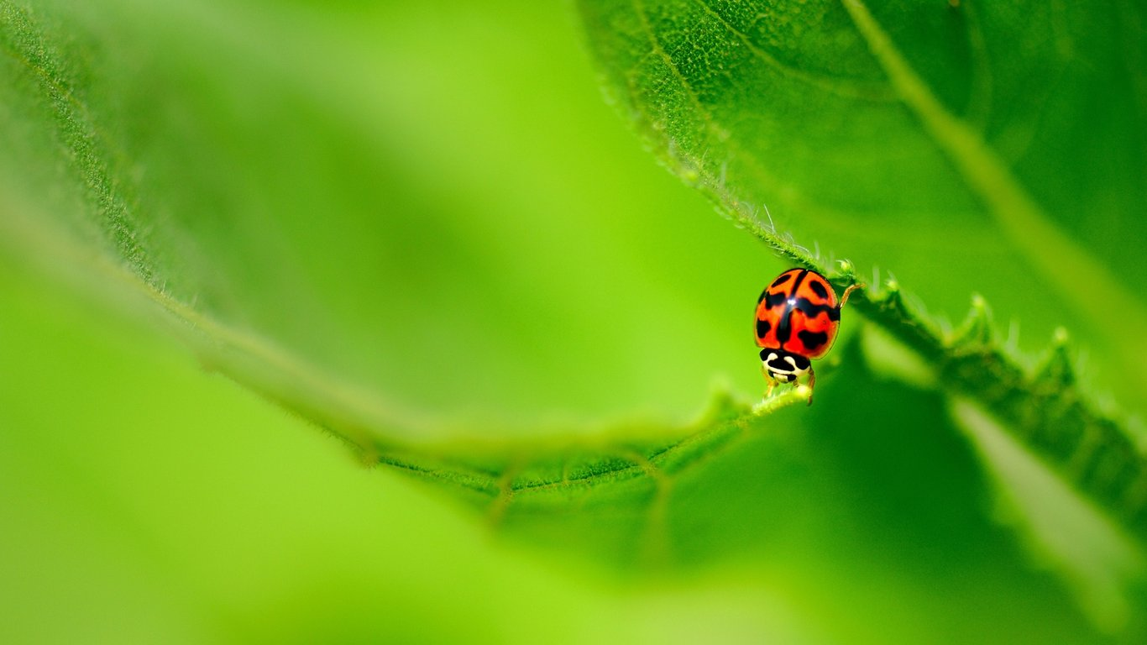
Ladybird, Class Insects

Slide 19
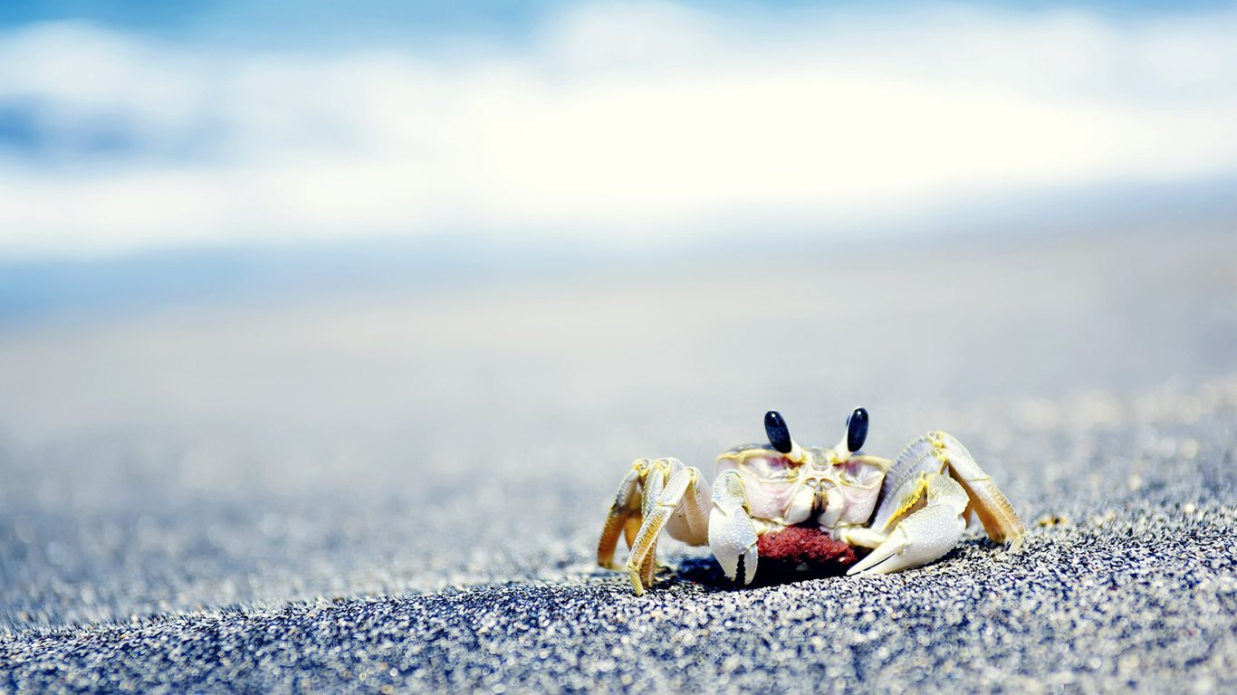
Crab, Class Crustaceans

